Slide 1
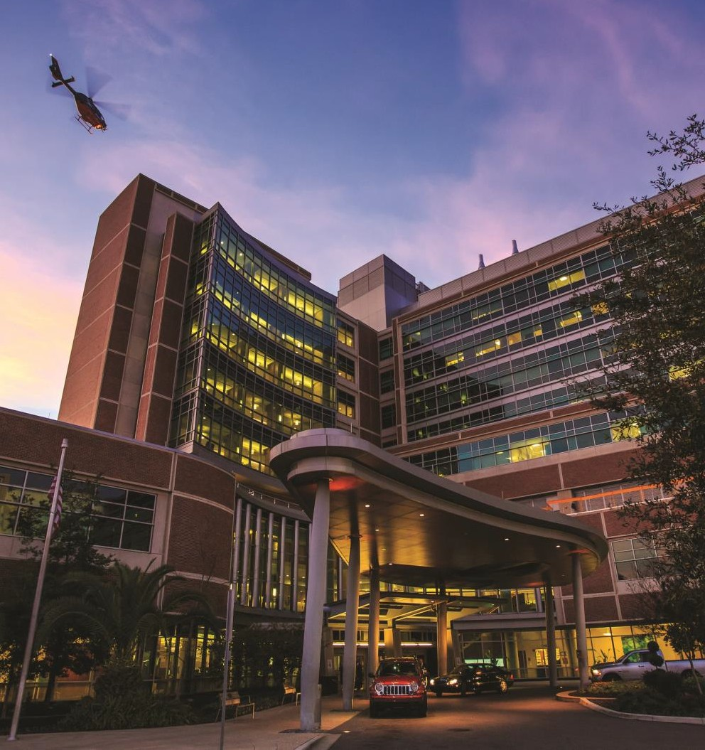
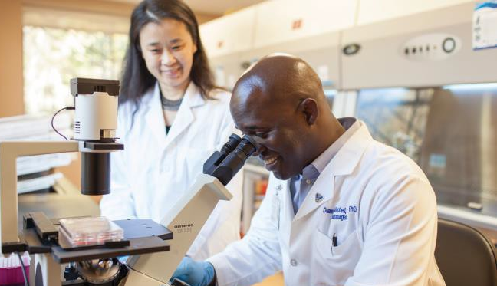
UF Health & Health Care Compliance
Robert Michalski | VP and Chief Compliance & Privacy Officer UF Health
UF Learn over Lunch – November 6, 2024

Slide 2
Agenda
Overview of UF Health and health care compliance
Regulatory oversight and enforcement in health care
Essential elements of an effective compliance program

Slide 3
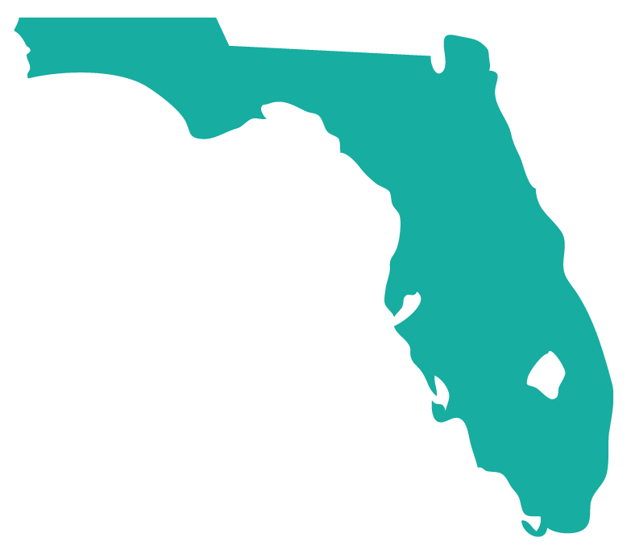
12
3
30,000+
1,600+
2,822
UF HEALTH
OVERVIEW
6
Hospitals
Animal hospitals
Faculty & staff
Residents & fellows
Licensed beds
Campuses
6
10
8,300+
117
2,700+
Health colleges
Research institutes
Students
Physician practice
& outpatient locations
Instructional, research
& clinical faculty
UF HEALTH — A DESTINATION FOR PATIENTS*
FACTS AT
A GLANCE
UF Health is part of a
#1
4M+
Patient
Visits
PUBLIC UNIVERSITY
The Wall Street Journal
438,875
$6.3B
$17.6M
20,152
Patients from across the U.S.
Patients treated from all 67 counties in Florida, the third most populous state in the nation
Revenue, all missions
Royalties & licensing
(outside of Florida)
$470.6M
Countries from which patients came to us
40
Research awards
*Excludes UF Health St. Johns (formerly Flagler Health+)
FY23 data

Slide 4
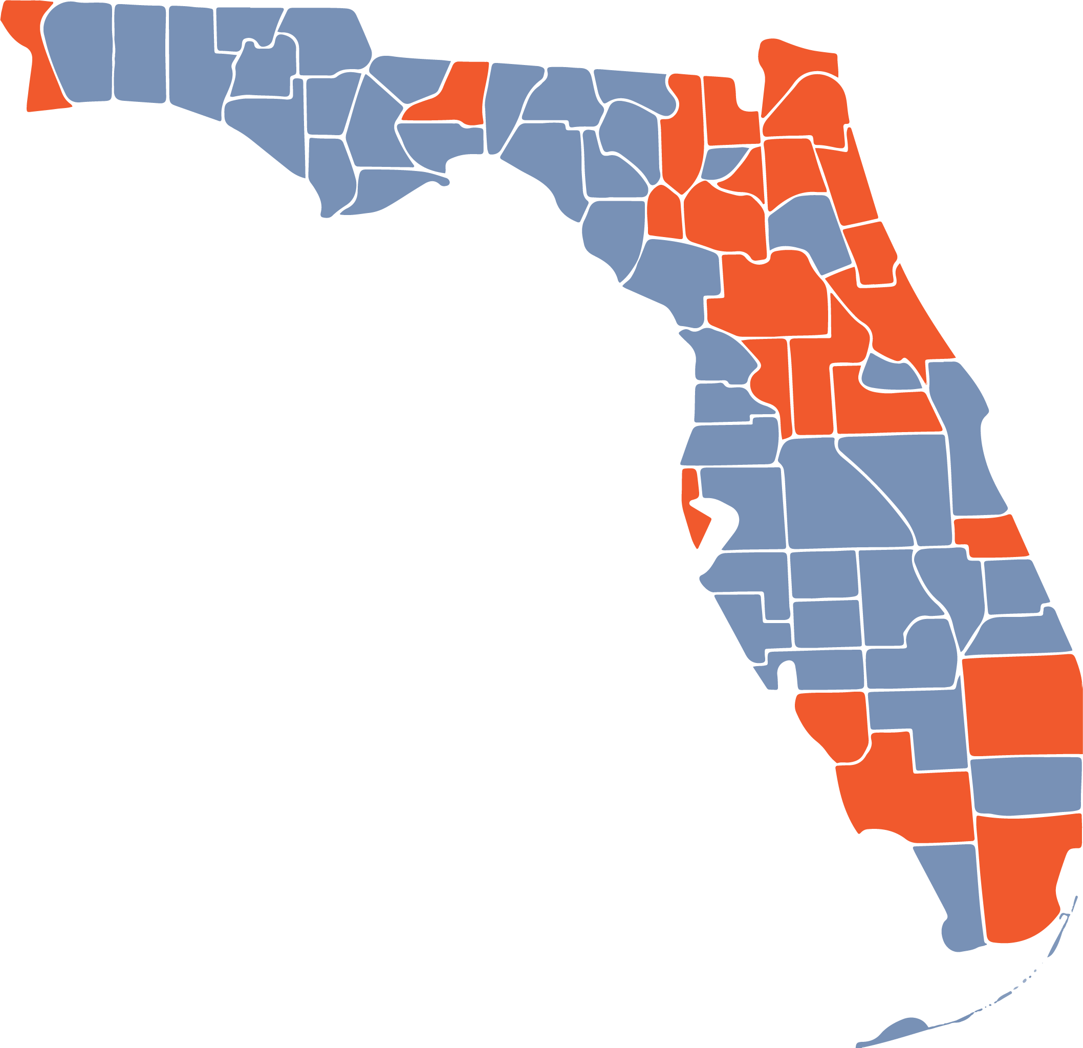
12
Hospitals
117
Physician Practices & Outpatient Locations
1
Mobile Stroke Unit
UF Health
Statewide Impact
6
Veterinary Medicine Hospitals & Clinics
15
Dental Centers
11
Hospital
Dentistry
Pharmacy Practices
6
Physician Practice
Pharmacy
Nursing Practices
Mobile Stroke Unit
Nursing
6
Veterinary Medicine
Academic/Research
Campuses

Slide 5
New UF Health Corporate Governance Structure
New Corporate Governing Board: The board is responsible as the corporate fiduciary, advising and holding the CEO and management team accountable to achieving their goals. The board has oversight and governing responsibility for the clinical enterprise, including hospitals and our two faculty physician group practices
This is under the governance of the UF BOT.
Embracing Systemness: This approach emphasizes our interconnectedness as an organization across departments, units, practices, and hospitals, and the importance of working together toward common objectives.

Slide 6
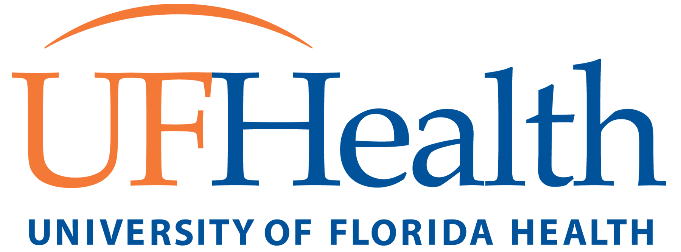
U.S. Olympic/Paralympic Partnership
First comprehensive medical center to join as a national partner
Only medical network member in the Southeastern U.S.
Effective August 2023
Notes:
Joining the United States Olympic & Paralympic Medical Network means we are a designated location for Team USA athletes should they need care for any reason.
In August 2023, UF Health became the 9th Health Care provider nationally and the first in the Southeast to become a and Olympic and Paralympic medical network member. We are just one of three to be a national medical center meaning we will accept athlete patients from every state and internationally.
In the first 6 months (mid-August through mid-February) we cared for 32 Team USA athletes. They had travelled to us from 14 different states and 3 foreign countries to receive care. This included both able-bodied and para athletes who participate in a variety of summer and winter sports. The care for these athletes included physicians from 10 different medical specialties as well as medical imaging, rehab services and four who had surgery. We are receiving the highest satisfaction scores of any partner in the medical network and due to the excellent reputation at UF Health, we have had several winter sports athletes travel from Utah, Colorado and New York to receive care here in Florida despite them having access to medical network members that were closer to them.

Slide 7
What is Health Care Compliance?
The ongoing process of meeting or exceeding the legal, ethical, and professional standards applicable to a particular health care organization or provider.
Promote prevention, detection and correction of instances of conduct that do not conform to federal and state law, health care program requirements, and the hospital’s ethical and business policies.
Notes:
Health care compliance can be defined as the ongoing process of meeting or exceeding the legal, ethical, and professional standards applicable to a particular health care organization or provider.
Compliance programs promote prevention, detection and resolution of instances of conduct that do not conform to federal and state law, health care program requirements, and the hospital’s ethical and business policies.

Slide 9
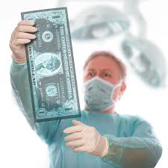
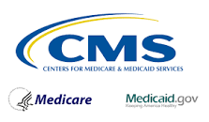
Examples of Health Care Compliance Regulations
Social Security Act
Health Insurance Portability and Accountability Act (HIPAA)
False Claims Act
Anti-Kickback Statute
Physician Self-Referral Law (Stark Law)
Patient Protection and Affordable Care Act
Beneficiary Inducements Civil Monetary Penalties
Centers for Medicare and Medicaid Services

Slide 10
Health Care Compliance Enforcement Examples
Sibley Hospital and Johns Hopkins Health System - $5 Million: April 2023 self-disclosure and settlement to resolve Stark Law allegations that compensation for ten cardiologists exceeded fair market value.
University of Miami - $22 Million: 2021 settlement to resolve allegations that it violated the False Claims Act by ordering laboratory tests that did not meet medical necessity requirements, and also for failing to provide patients required Medicare notices at off-campus hospital clinics.
HMA Hospital Chain - $260 Million: 2018 settlement to resolve three allegations: (1) HMA billed for inpatient services that should have been billed as outpatient; (2) HMA made improper payments to referring physicians by providing free office space and staff; and (3) HMA pressured physicians to increase emergency department patient admissions without regard to medical necessity.
Notes:
The following examples demonstrate the significant fines healthcare organizations can face when regulations are not followed, even when noncompliance is unintentional:

Slide 11
Compliance Program Infrastructure: The Seven Elements
Element 1: Written Policies and Procedures
Element 2: Compliance Leadership Oversight
Element 3: Training and Education
Element 4: Effective Lines of Communication with the Compliance Officer and Disclosure Program
Element 6: Risk Assessment, Auditing, and Monitoring
Element 5: Enforcing Standards: Consequences and Incentives
Element 7: Responding to Detected Offenses and Developing Corrective Action Initiatives

Slide 12
DOJ Guidance for Compliance Programs
Is the corporation’s compliance program well designed?
Is the program being applied earnestly and in good faith? In other words, is the program adequately resourced and empowered to function effectively?
Does the corporation’s compliance program work in practice?

Slide 13
Written Policies and Procedures
Align multiple Codes of Conduct & Policies
One set of standards
One UF Health
Notes:
When it comes to our written policies and procedure, we are working on aligning our codes of conduct and policies to create one set of standards going forward. This change will allow us to operate more effectively and collaboratively, to align our strategic goals with a common mission, vision and values across our regional health campuses in Gainesville, Jacksonville, St. Johns and Central Florida. Ultimately, we will become one UF Health.

Slide 14
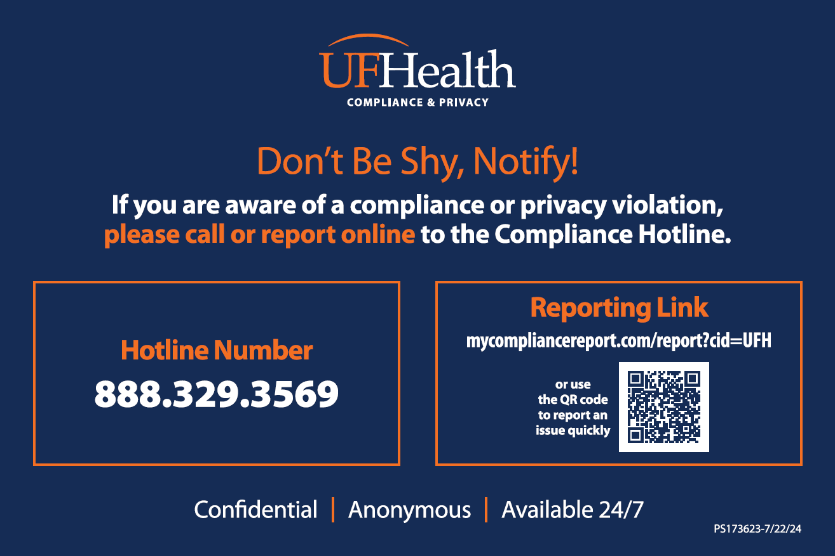
Effective Lines of Communication
Open door reporting system
Non-Retaliation and Confidentiality
External Hotline
Notes:
Provide an open door reporting system where employees feel comfortable
Non-retaliation and confidentiality must be key components
Recommend an external hotline and other forms of information exchange

Slide 15
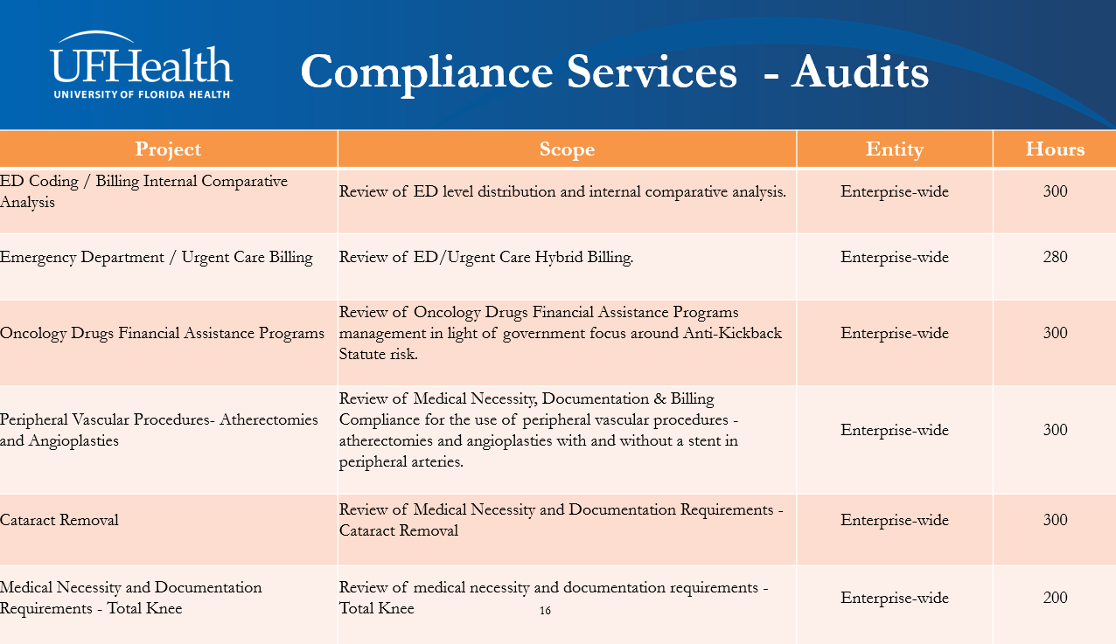
Risk Assessment, Auditing, and Monitoring
Thorough monitoring and regular reporting
Regular, periodic compliance audits
Any overpayments addressed promptly

Slide 16
Contacting Compliance & Privacy Services

Slide 17
Compliance
A regulatory requirement and the right thing to do
A shared enterprise-wide responsibility
A resource for all

Slide 18
UF Health & Health Care Compliance
Robert Michalski | VP and Chief Compliance & Privacy Officer UF Health
UF Learn over Lunch – November 6, 2024

